Slide 1


ROUTING
OPTIMIZATION
FOR
AERONAUTICAL
NETWORKS
PRESENTED TO
Dr Makkaddan
PRESENTED BY
Adnan Ghani
Kumar Malay
Mrinal Naveen
05-06-2023

Slide 2

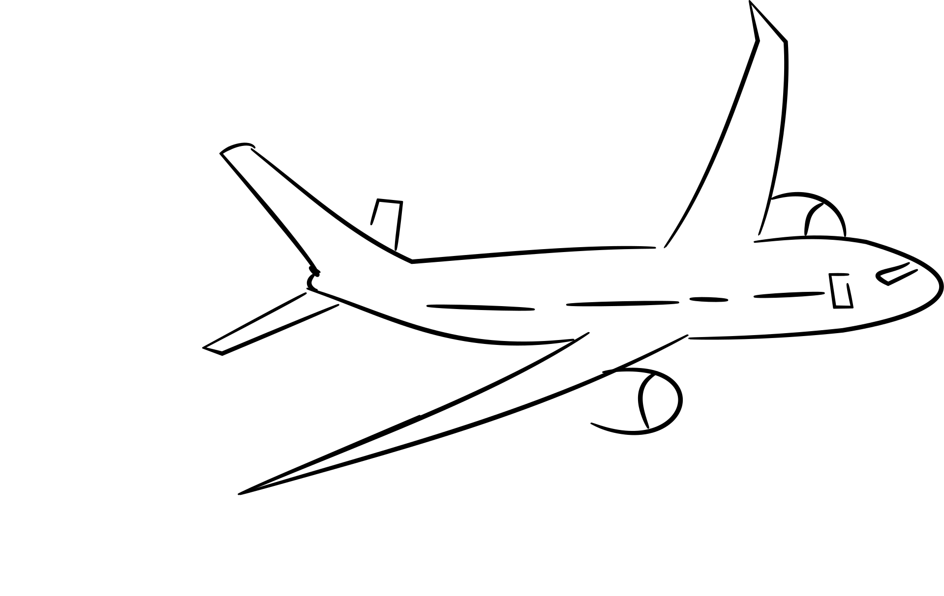
Introduction
In today's world, thousands of airplanes traverse the skies every day, transporting passengers to their destinations.
With the increasing demand for connectivity, providing reliable internet access to passengers onboard has become a critical challenge.
This project focuses on optimizing data packet routing paths for airplanes to ensure seamless internet connectivity throughout their journey.
Optimizing routing paths involves addressing the challenges posed by the dynamic nature of the network and the need to maximize data transmission rate while minimizing latency.
The project aims to tackle both single-objective and multiple-objective optimization problems to find optimal routing paths.
Let's delve deeper into the methodology and explore the innovative approaches used to tackle these optimization problems.

Slide 3

Background
The issue of route optimisation for aviation networks is the project's main concern. It addresses the difficulty of giving aeroplanes flying over the North Atlantic region internet access. Finding the best routes for data packets from each aircraft to a ground station (GS) at either Heathrow Airport (LHR) or Newark Liberty International Airport (EWR) is the objective.
Problem Statement
The challenge is to provide up effective internet connection for passengers onboard aircraft travelling over the North Atlantic region by optimising the routing paths. End-to-end latency and end-to-end data transfer rate are two measures that should be taken into account during optimisation.

Slide 4

Problem Description:
The problem involves optimizing routing paths for airplanes flying over the North-Atlantic in order to provide internet access to passengers onboard. The goal is to find optimal data packet routing paths based on two metrics: end-to-end data transmission rate and end-to-end latency.
Single-objective Optimization:
For each airplane that can access a ground station (GS) at either Heathrow airport (LHR) or
Newark Liberty International Airport (EWR), the objective is to find a routing path with the
maximum end-to-end data transmission rate.
Multiple-objective Optimization:
For each airplane that can access a ground station (GS) at either Heathrow airport (LHR) or
Newark Liberty International Airport (EWR), the objective is to find a routing path with
both the maximum end-to-end data transmission rate and the minimum end-to-end
latency.

Slide 5
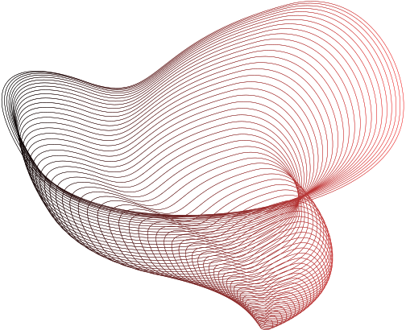

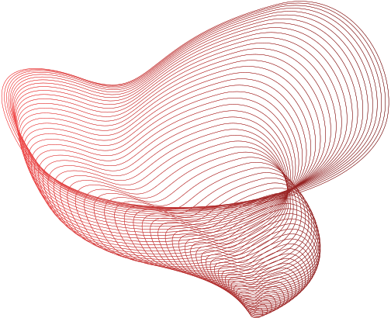
Methodology
Single-objective optimization:
The objective is to find a routing path for each airplane that maximizes the end-to-end data transmission rate.
The routing path should enable the airplane to access a ground station at either Heathrow airport (LHR) or Newark Liberty International Airport (EWR).
The implementation involves developing an optimization algorithm to determine the optimal routing paths.

Slide 6

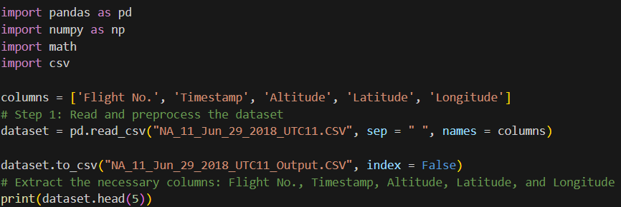

Steps Involved:
Step 1: Dataset Correction

Slide 7
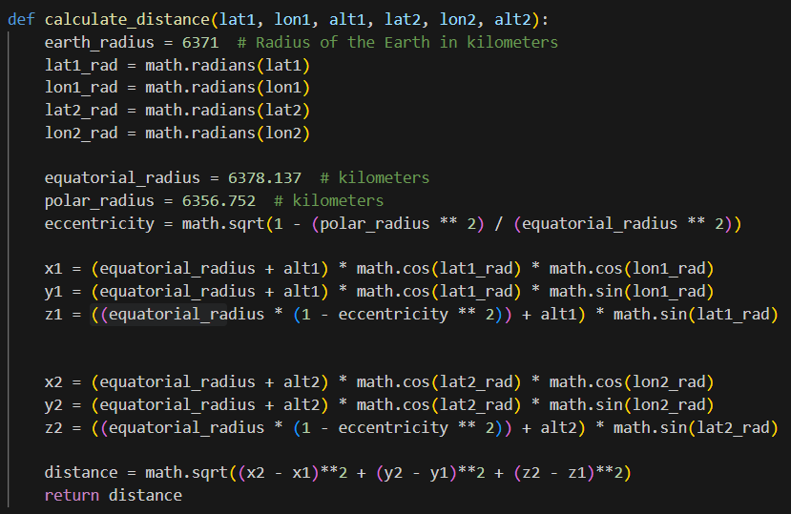
Step 2: Conversion to 3D Cartesian Coordinate
and finding the Distance Between them

Slide 8
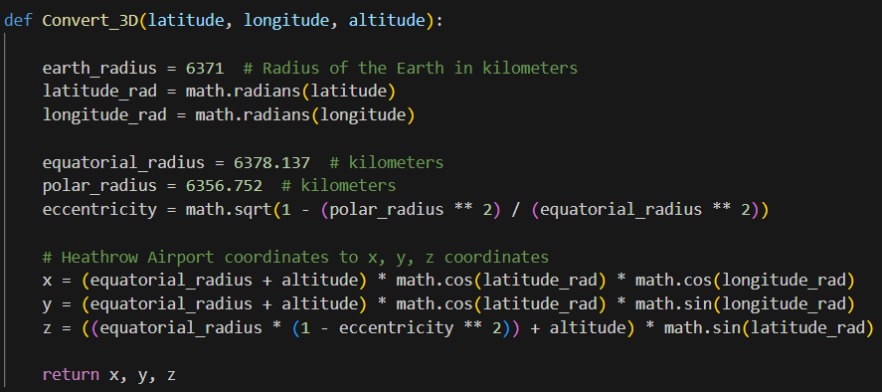
Step 3: Conversion to 3D Cartesian Coordinates
for single value of coordinates
Using Heathrow Airport Coordinates Conversion

Slide 9
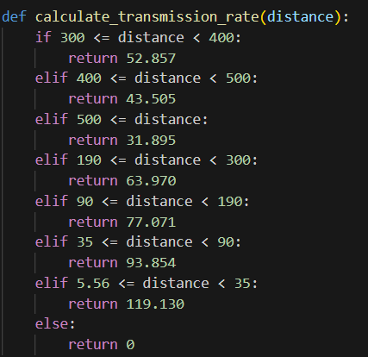
Step 4: To find Transmission Rate
Function to calculate the data transmission rate based on the distance between airplanes

Slide 10
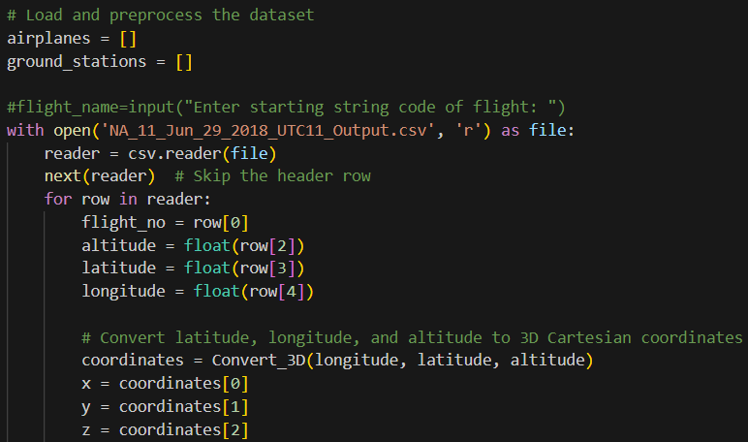
Step 5: Single Objective Optimization
(I)

Slide 11
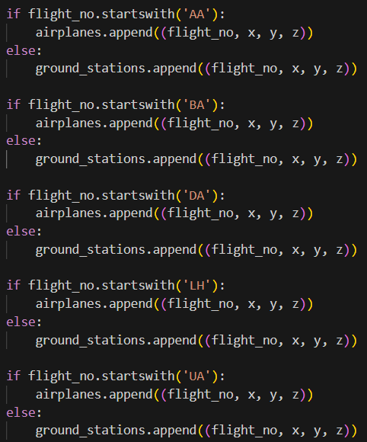
Step 6: Single Objective Optimization
(II)

Slide 12
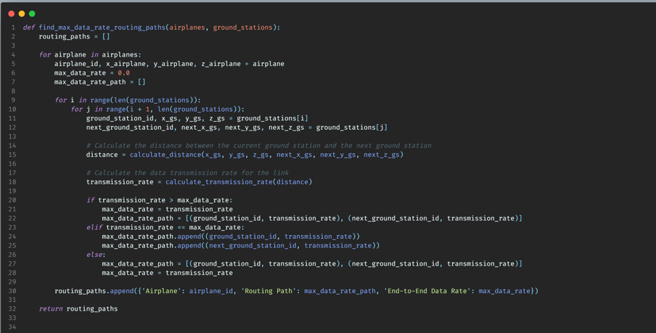
Step 6: Single Objective Optimization
(III)

Slide 13
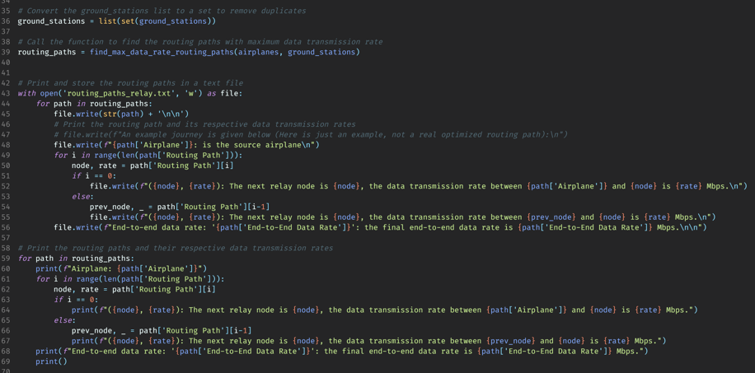
Step 6: Single Objective Optimization
(III)

Slide 14
REVIEW II

Slide 15
Methodology
Multiple-objective optimization:
The objective is to find a routing path for each airplane with both the maximum end-to-end data transmission rate and the minimum end-to-end latency.
The routing path should enable the airplane to access a ground station at either Heathrow airport (LHR) or Newark Liberty International Airport (EWR).
The implementation involves developing an optimization algorithm to determine the optimal routing paths.

Slide 16
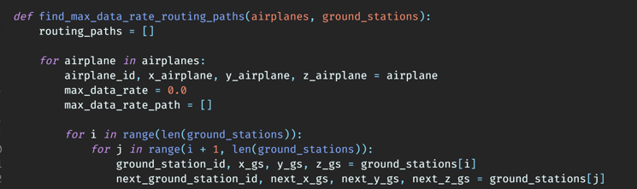
Steps Involved:
Step 1: Finding the optimal routing path

Slide 17
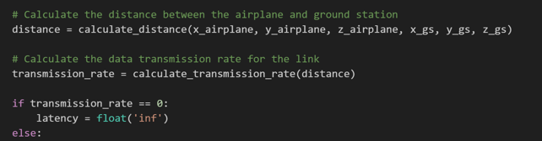
Step 2: Calculating the distance between airplane and Ground station and finding the transmission rate:

Slide 18
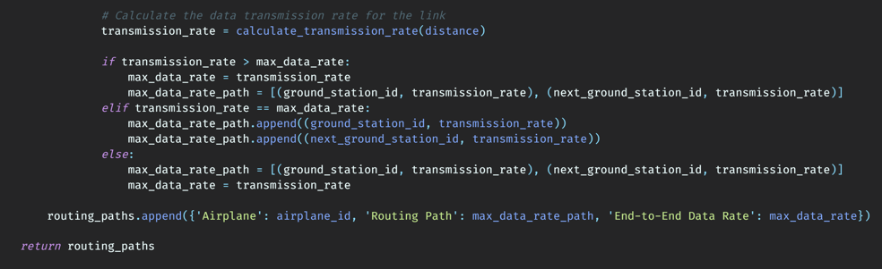
Step 3: Calculating the transmission rate for the link :

Slide 19
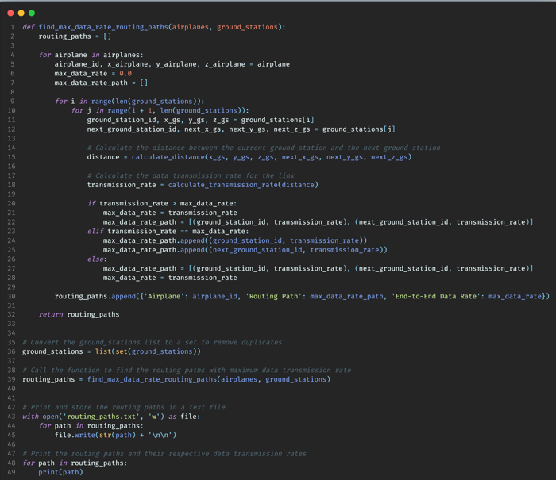

Slide 20
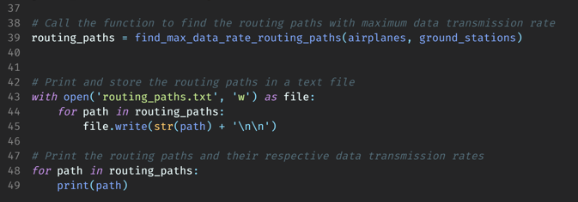
Step 4: Calling the optimal routing paths function and storing the found optimized paths in a text file:

Slide 21
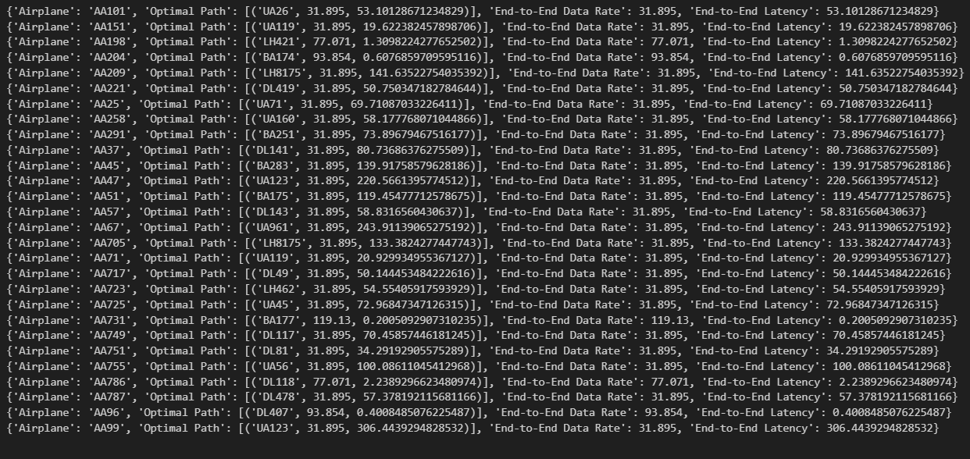
Multiple Objective Optimization: Output

Slide 22


THANK YOU

